Slide 1

Running the Elastic Stack On Kubernetes with ECK

Slide 2
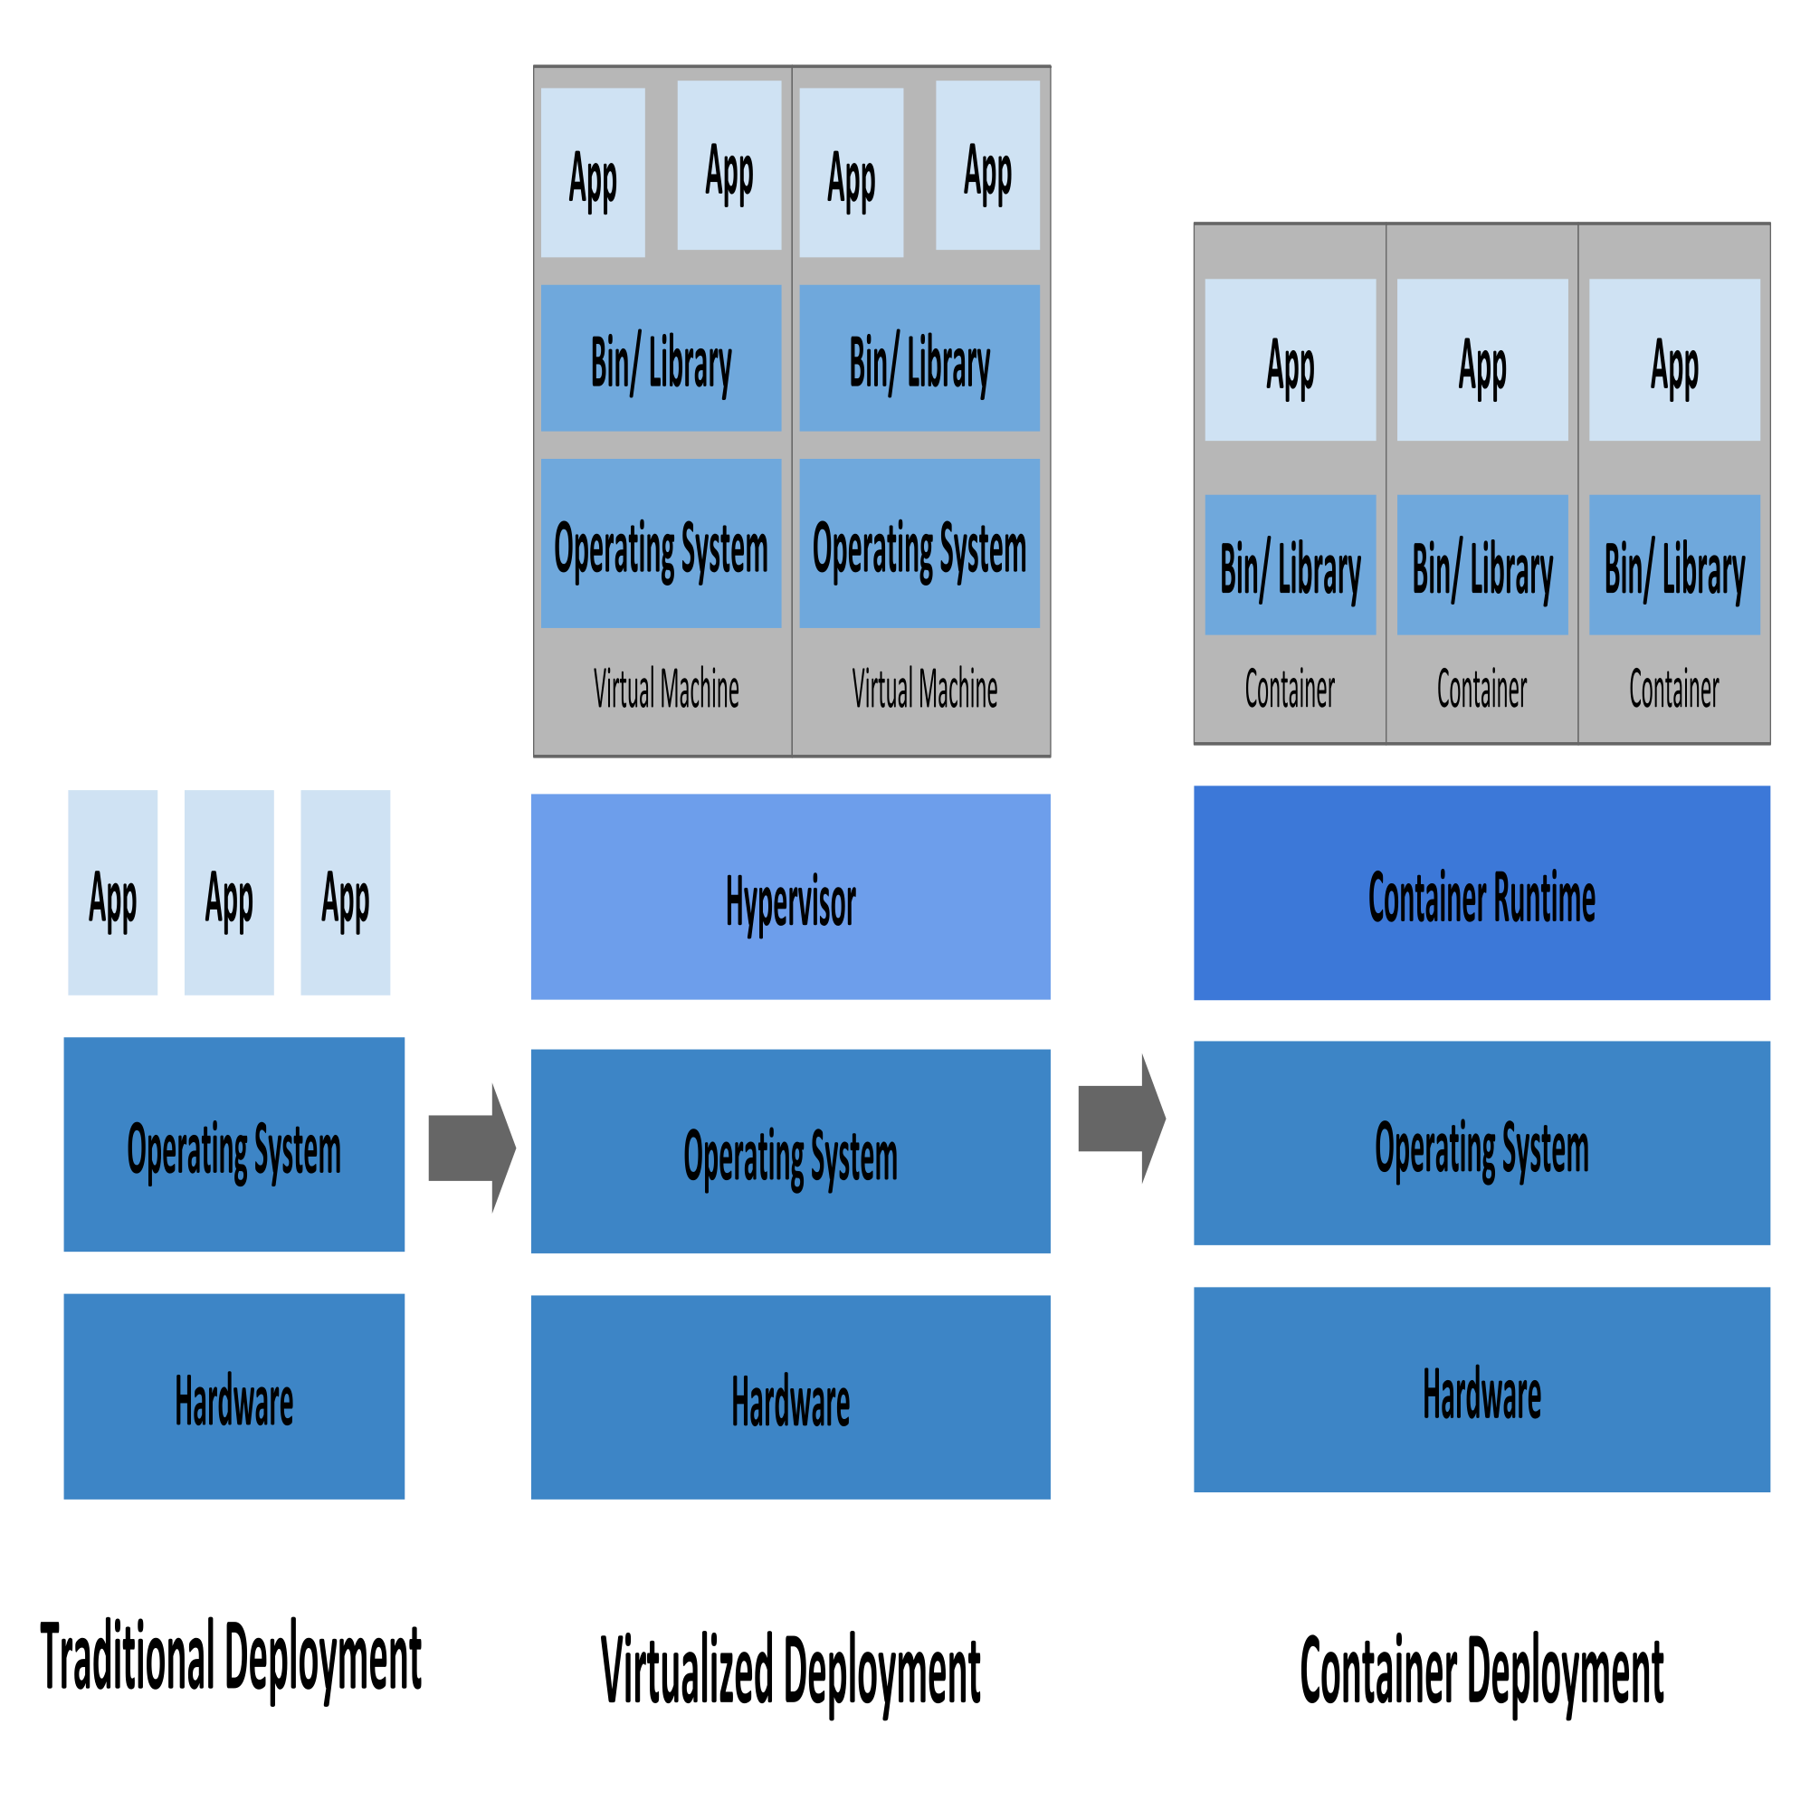
Hardware vs Virtual machine vs Container

Slide 3
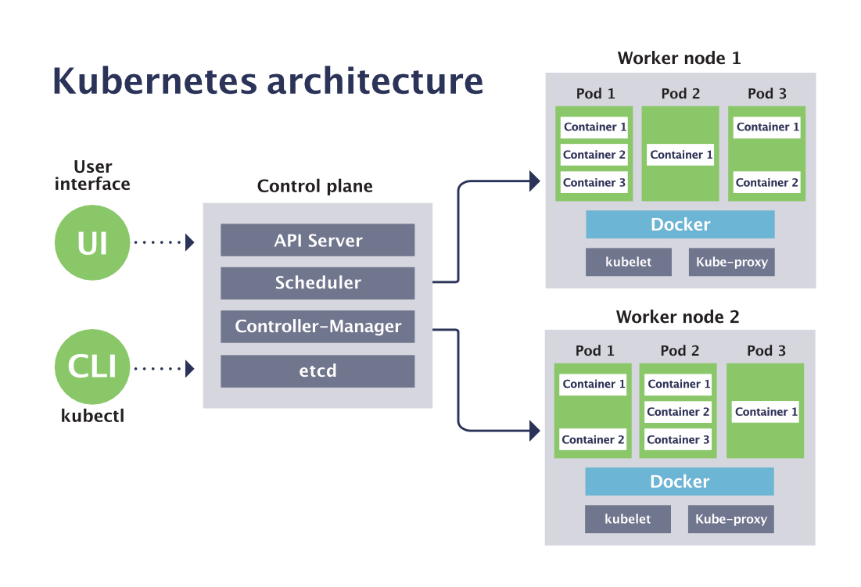
Kubernetes architecture

Slide 4
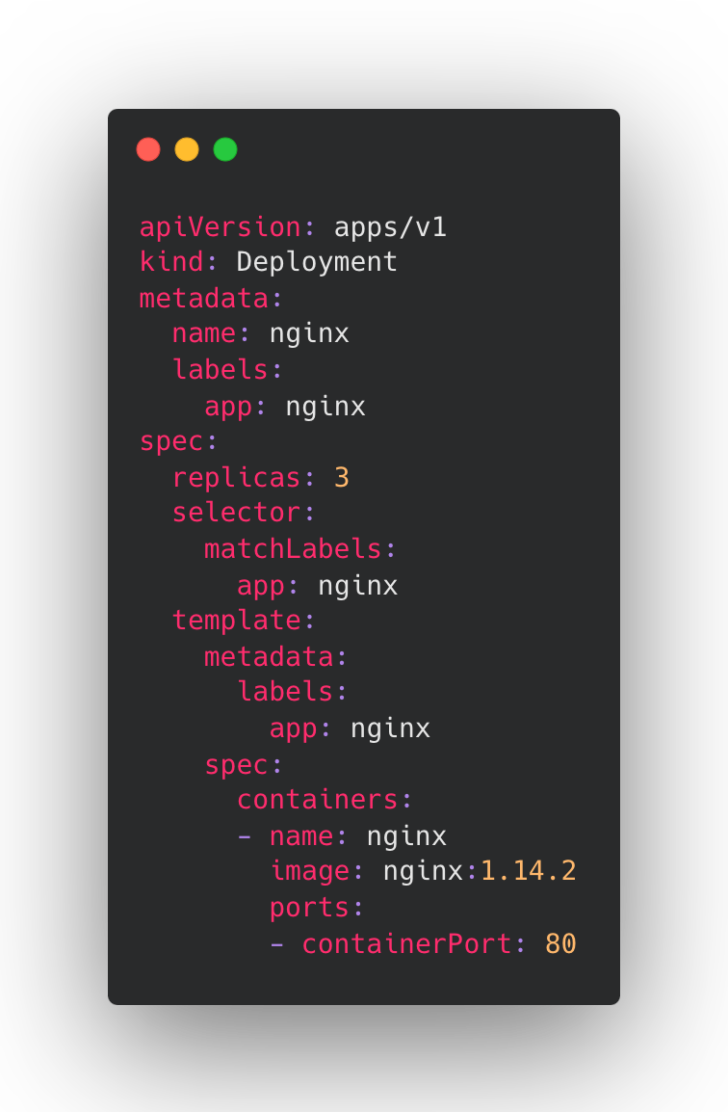
Deployment
Deployment
nginx
ReplicaSet
nginx-6595874d85
Pod
nginx-6595874d85-4t7k9
nginx-6595874d85-9pm6z
nginx-6595874d85-dxcs8

Slide 5
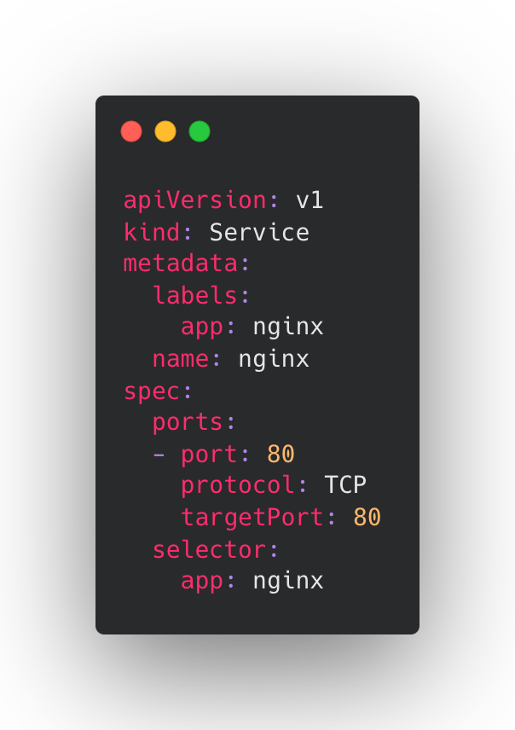
Service
client
nginx serivce
kube-proxy(iptables/ipvs)
nginx-6595874d85-4t7k9
nginx-6595874d85-9pm6z
nginx-6595874d85-dxcs8

Slide 6
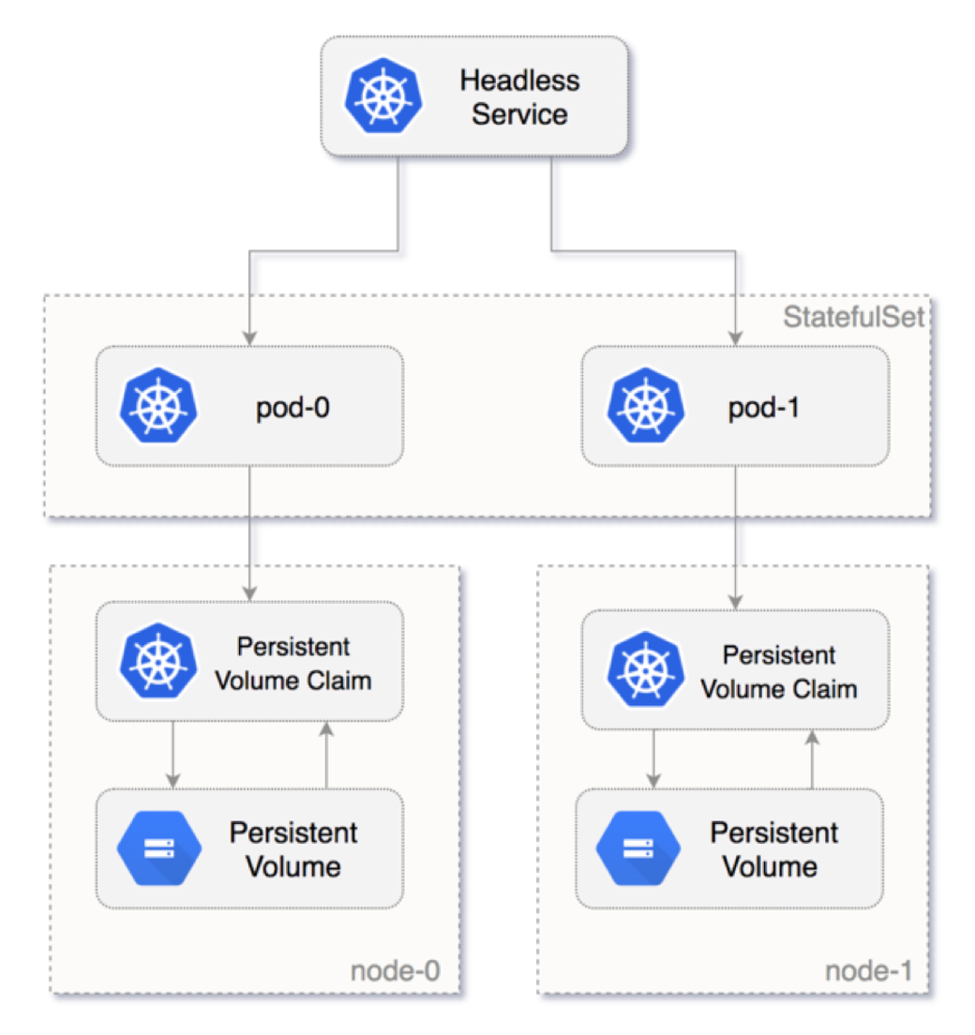
StatefulSet
<pod-name>.<namespace>.svc.<cluster-domain>
https://kubernetes.io/docs/concepts/services-networking/dns-pod-service/#pod-dns-config
https://kubernetes.io/docs/tasks/run-application/run-replicated-
stateful-application/

Slide 7
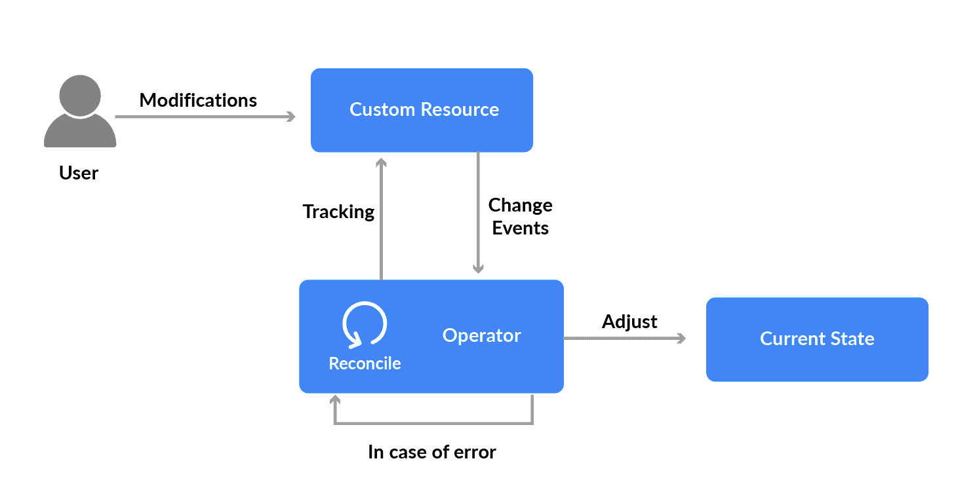
Kubernetes Operator
https://operatorhub.io/

Slide 8
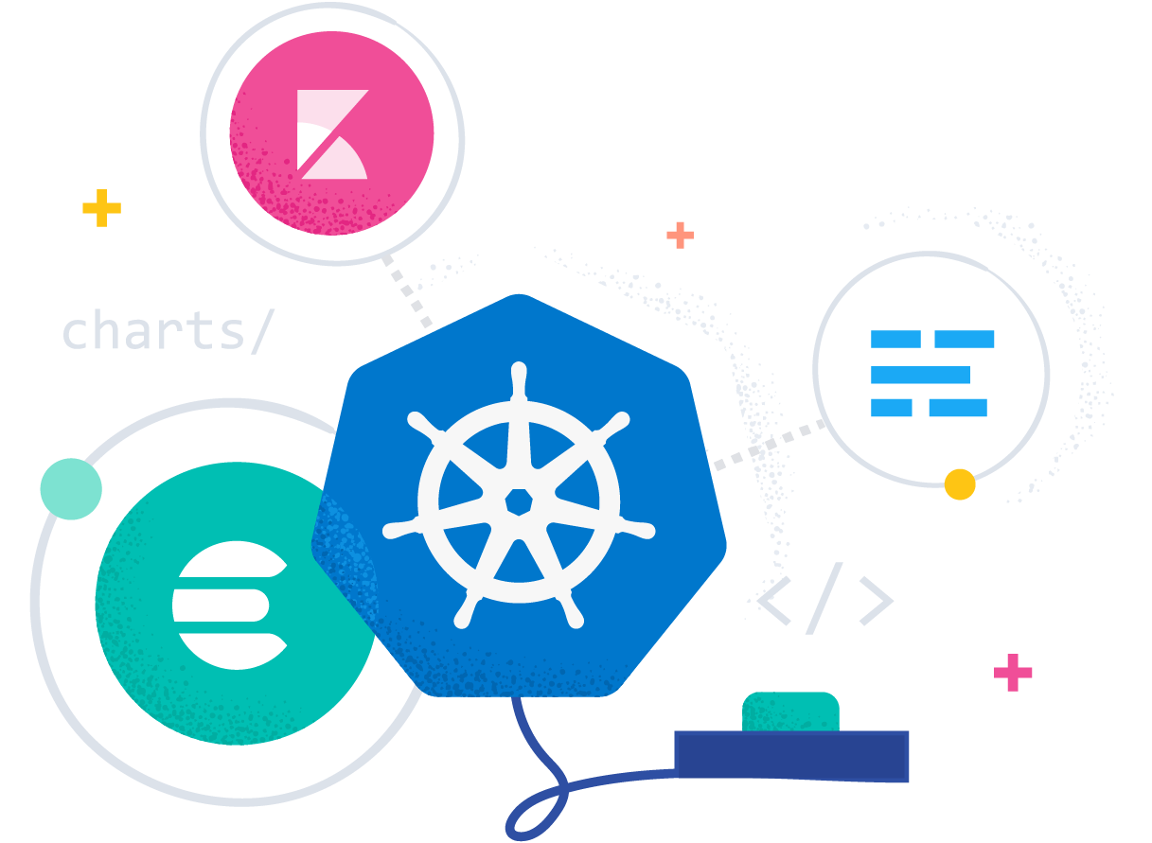
ECK
Elastic Cloud on Kubernetes (ECK) is the official operator by Elastic for automating the deployment, provisioning, management, and orchestration of Elasticsearch, Kibana, APM Server, Beats, Enterprise Search, Elastic Agent and Elastic Maps Server on Kubernetes.
https://www.elastic.co/guide/en/cloud-on-k8s/current/index.html

Slide 9
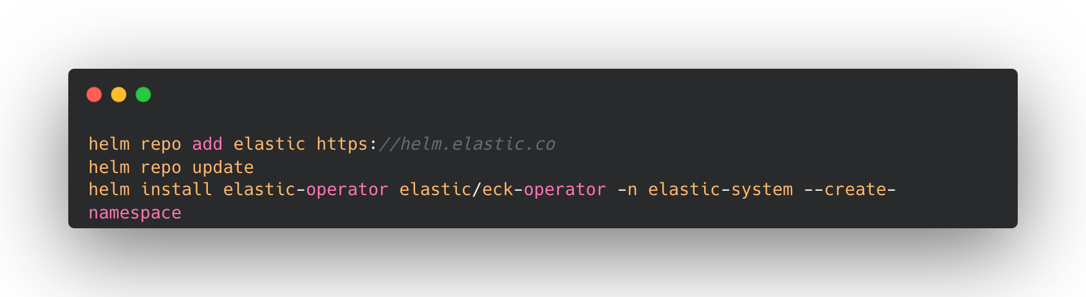
Install ECK

Slide 10
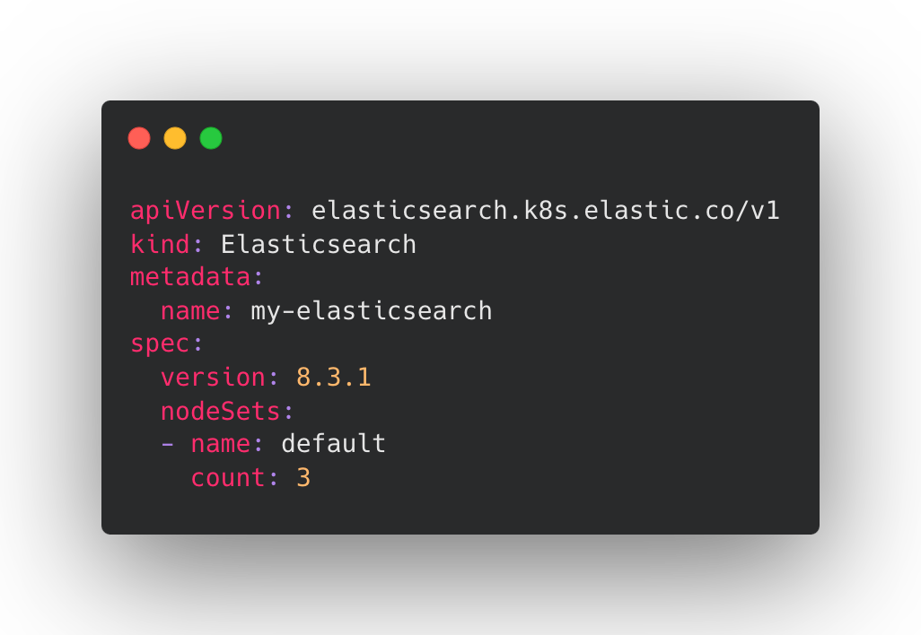
Elasticsearch
node-1
node-2
node-3

Slide 11
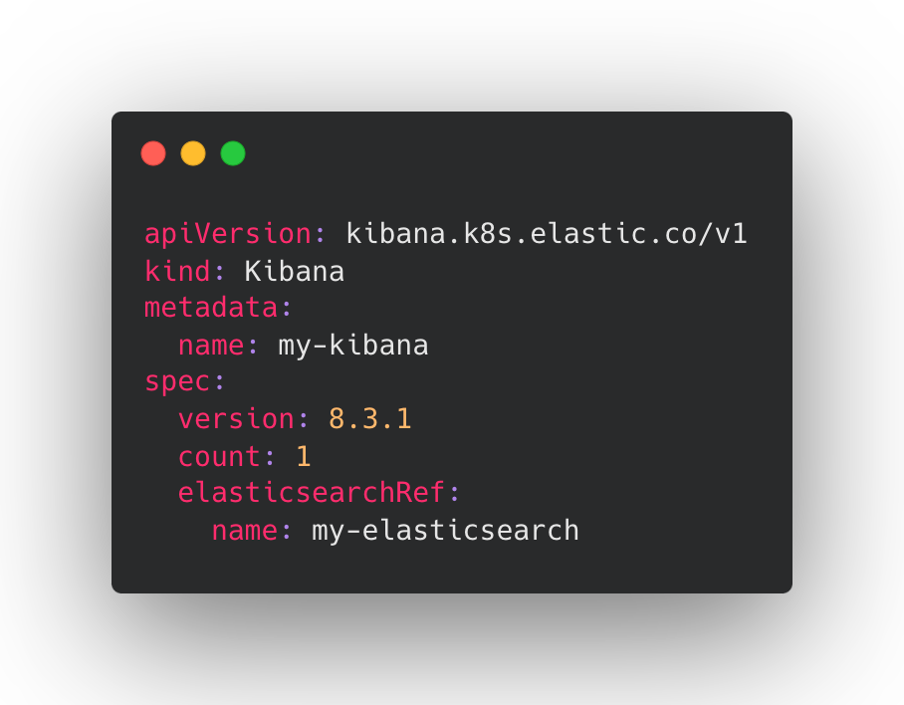


Kibana

Slide 12
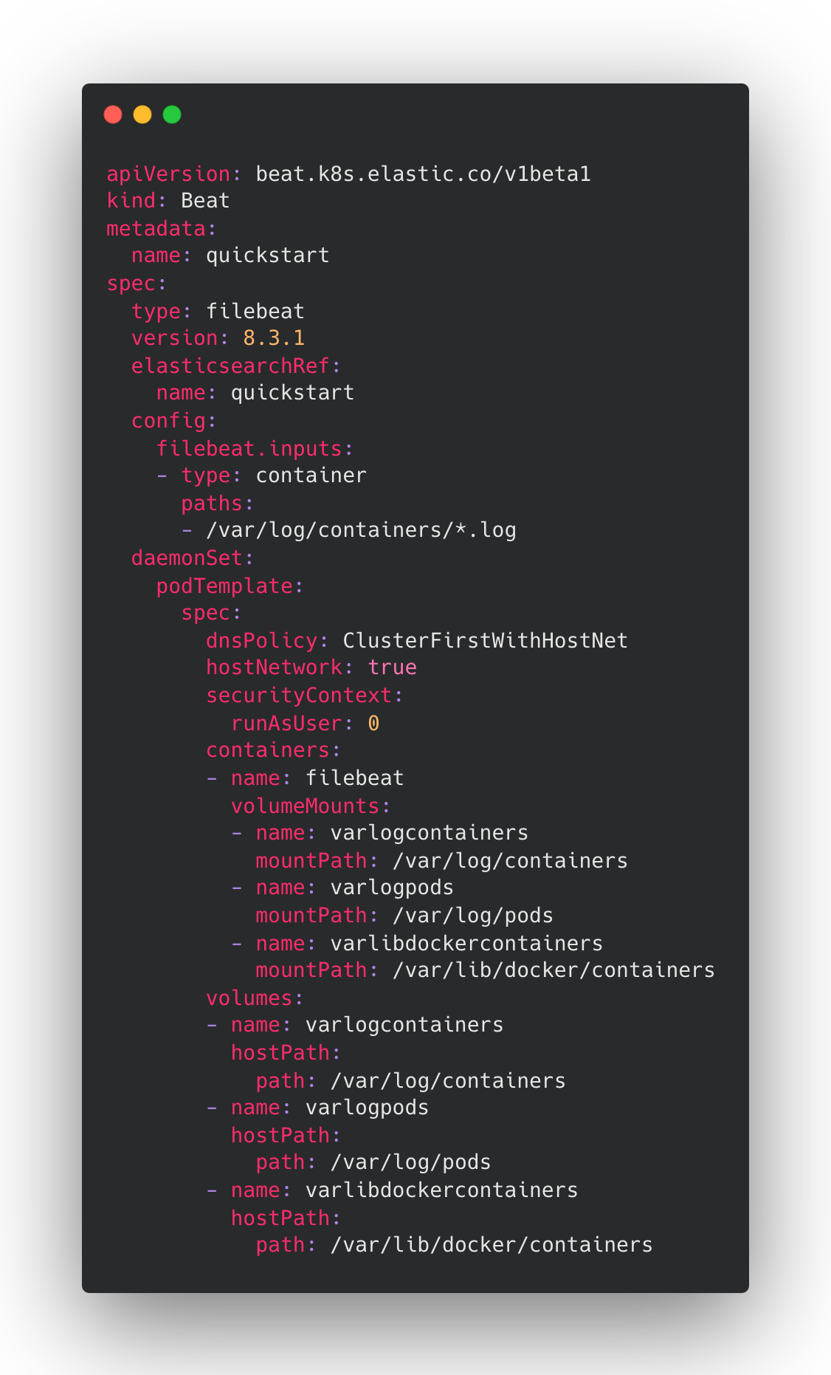
Beats
https://loggie-io.github.io/docs/user-guide/use-in-kubernetes/collect-container-logs/

Slide 13
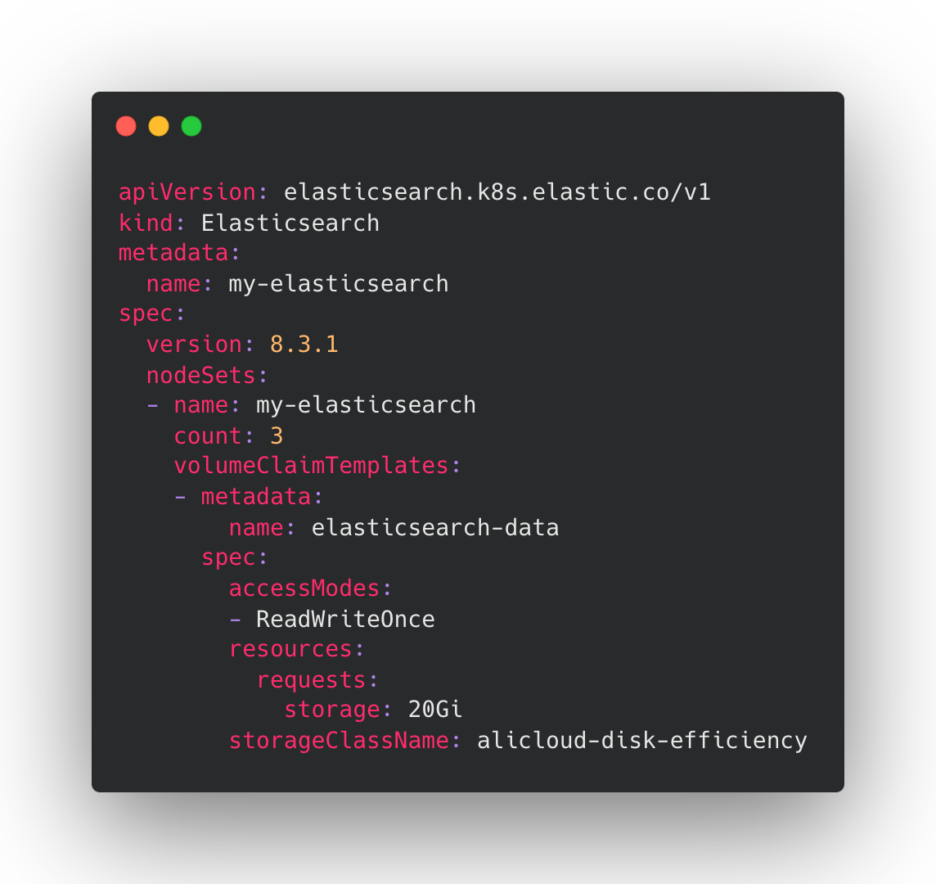
Storage

Slide 14
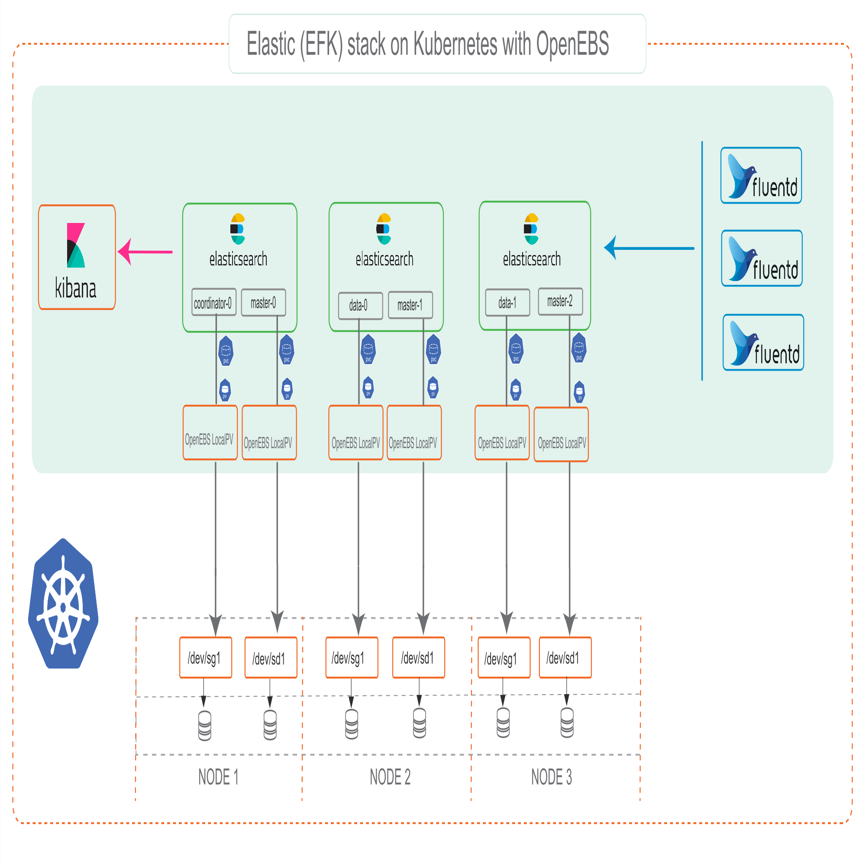
Storage

Slide 15
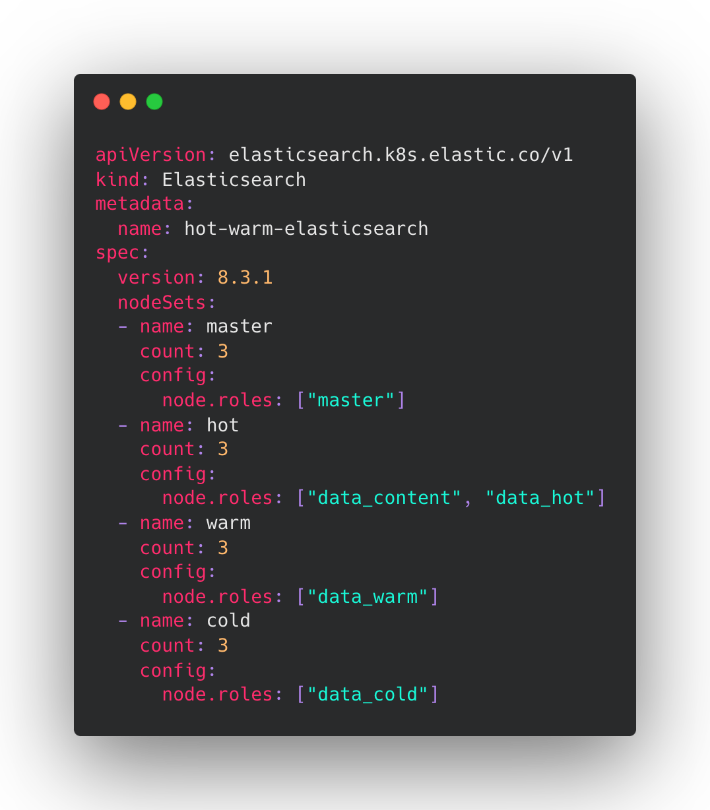
Hot-Warm topologies
master-node-1
master-node-1
master-node-1
hot-data-node-1
hot-data-node-2
hot-data-node-3
warm-data-node-1
warm-data-node-2
warm-data-node-3
cold-data-node-1
cold-data-node-2
cold-data-node-3

Slide 16
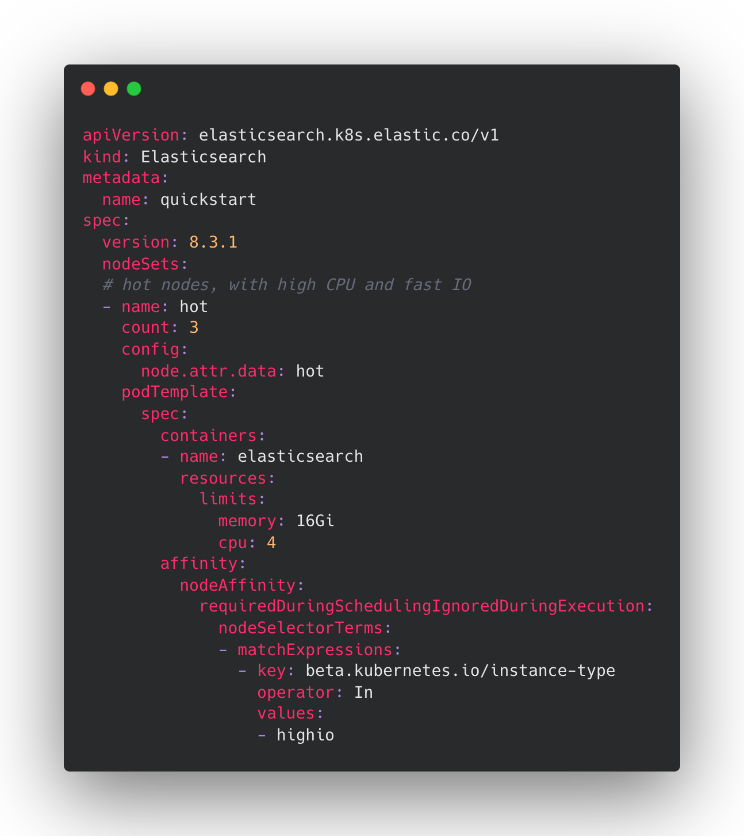
Schedule
https://www.elastic.co/guide/en/cloud-on-k8s/current/k8s-advanced-node-scheduling.html

Slide 17
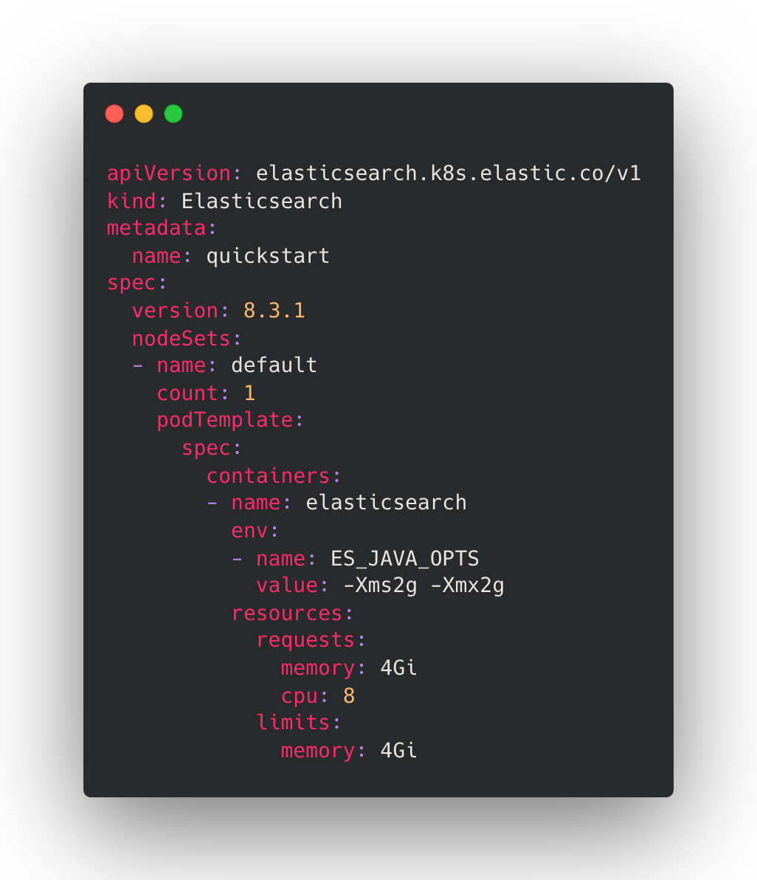
Resource limit

Slide 18
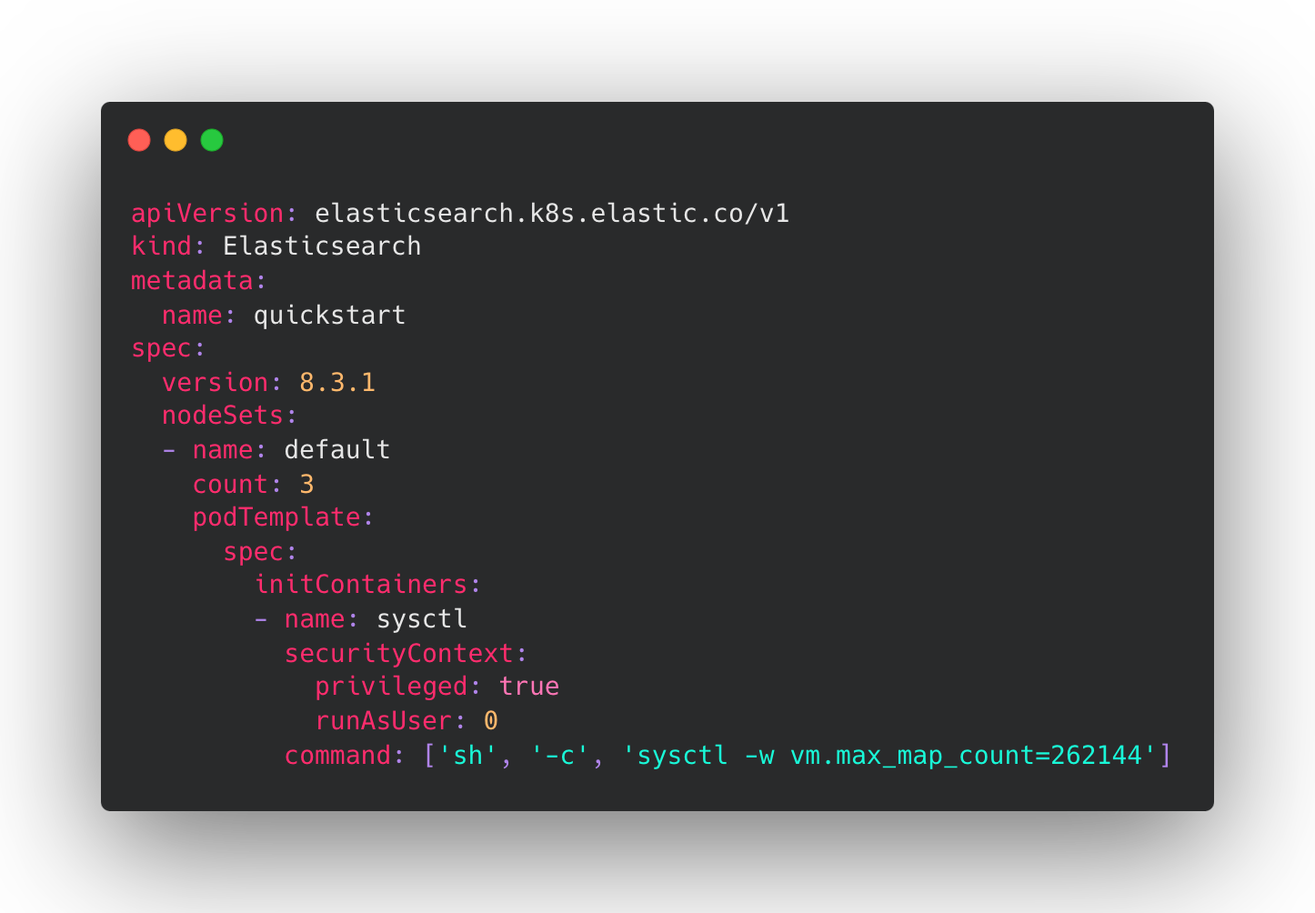
System configuration

Slide 19
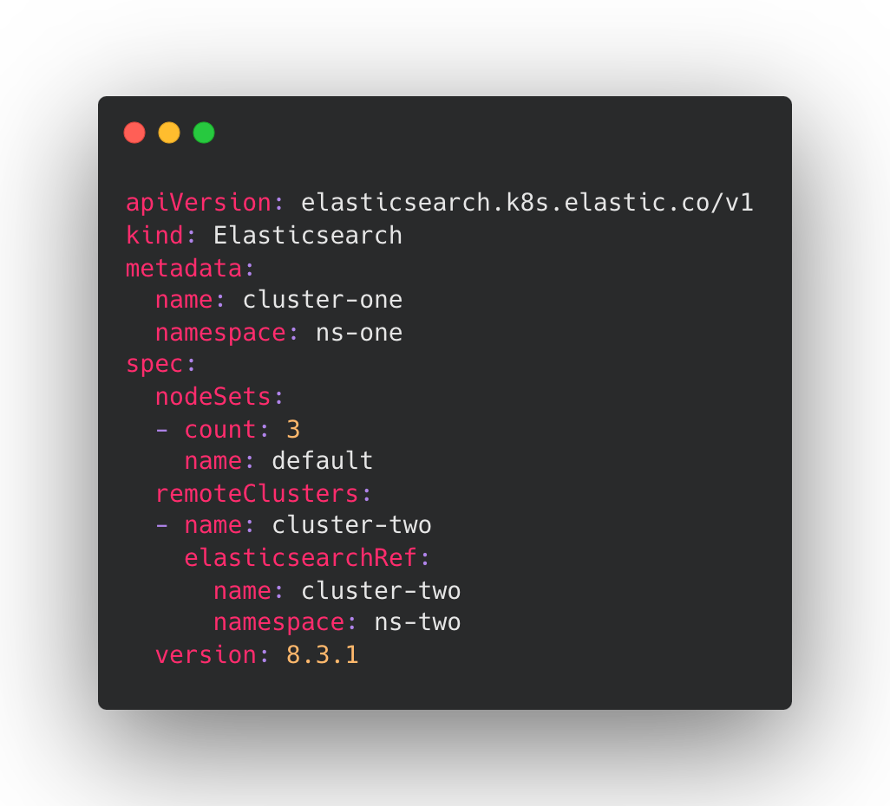
Remote clusters

Slide 20
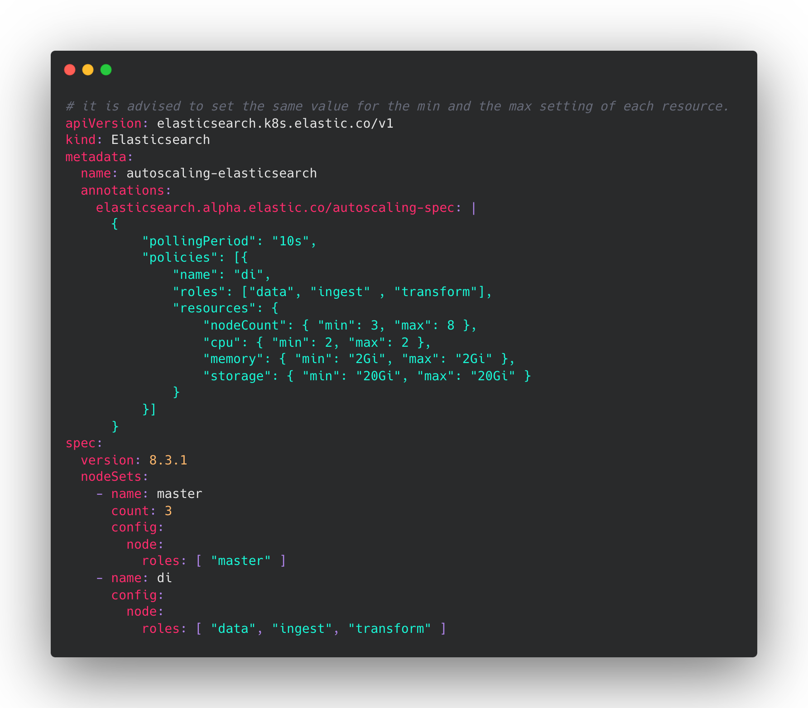
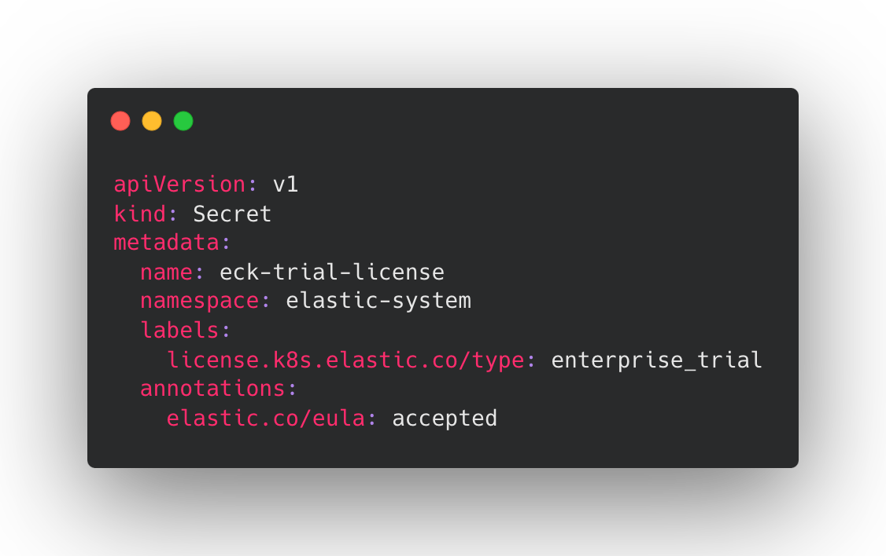
Autoscaling

Slide 21
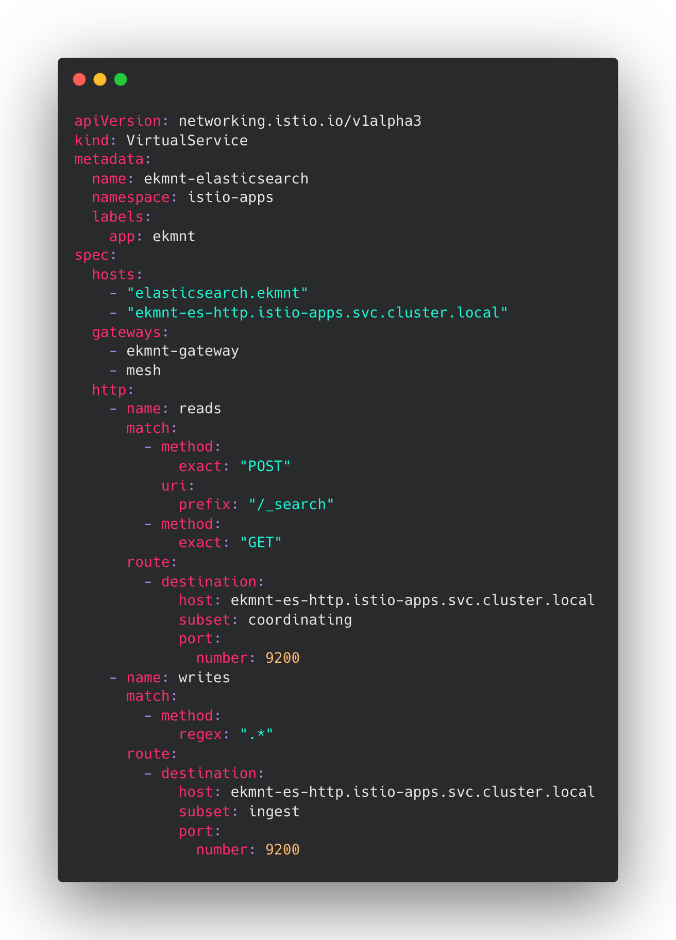
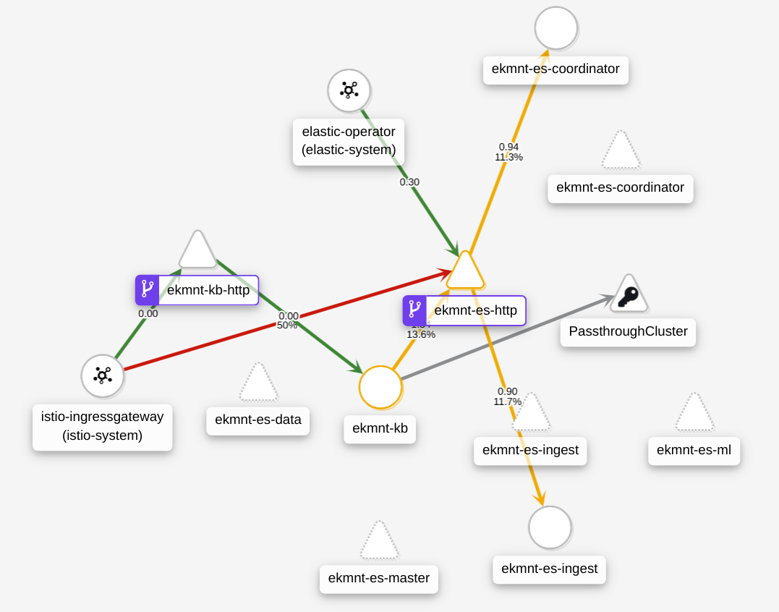
Integrate with Isito
https://github.com/elastic/cloud-on-k8s/tree/main/config/recipes/istio-gateway

Slide 22
Demo

Slide 23
Hands-On Lab
https://mp.weixin.qq.com/s/pByZr88Lf5JosOnbGf3WDg

Slide 24


THANK YOU

